Slide 1

Advanced Smart AI Agent for Project Management
Prepared by: Omar Ismail & Roudy Barakat
Presented to: Dr. Mohamad AOUDE
Course: Mini Project – ULFG III
Date: June 18, 2025

Slide 2

Introduction & Problem Statement
Modern project management is often reactive.
Common problems: delayed detection of budget overruns, missed deadlines, overloaded employees.
Our system uses an autonomous AI agent, "Lama3", to analyze KPIs and predict risks.
Provides early alerts to project managers for proactive decision-making.

Slide 3

System Architecture
Three-tiered architecture:
Frontend (React): UI for users
Backend (FastAPI): Handles logic & integrates Lama3
Database (MySQL) Stores projects, tasks, KPIs, alerts…
Lama3 AI agent: Built into backend

Slide 4

Backend
FastAPI: Runs the system fast and handles requests
SQLAlchemy: Connects Python to the database
Data Models: We created tables for employees, projects, tasks, alerts, and more
CRUD Operations: Add, view, update, and delete data

Slide 5
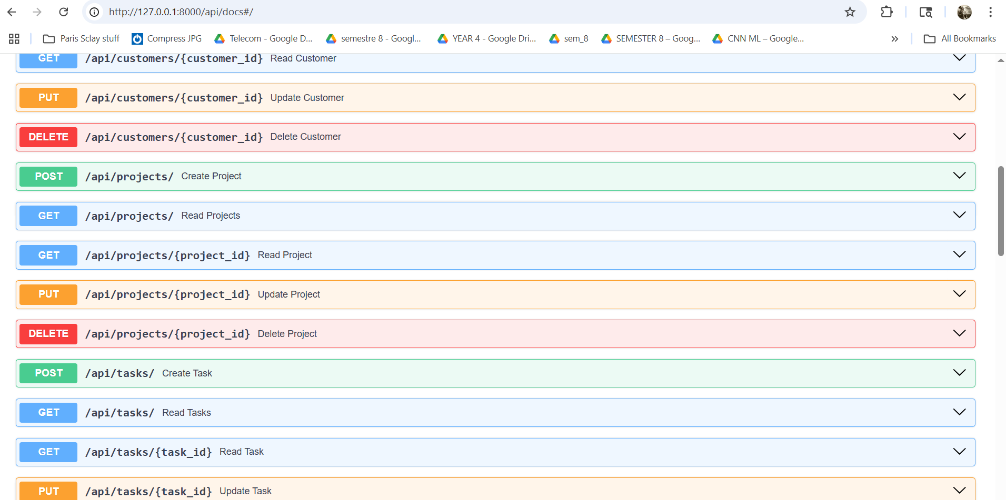
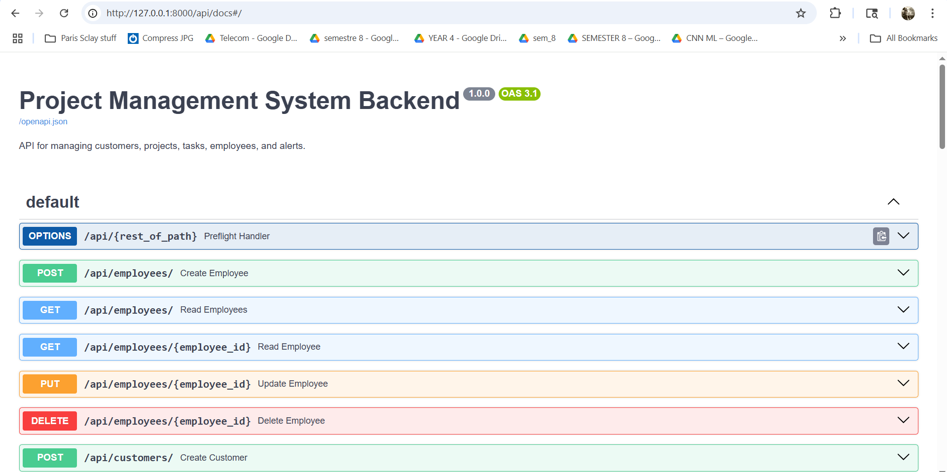
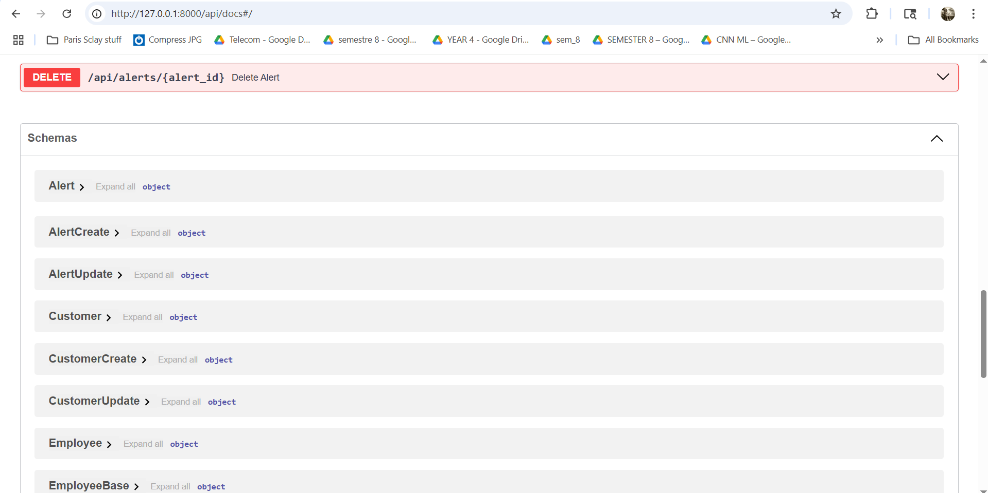
CRUD Endpoints in Swagger

Slide 6
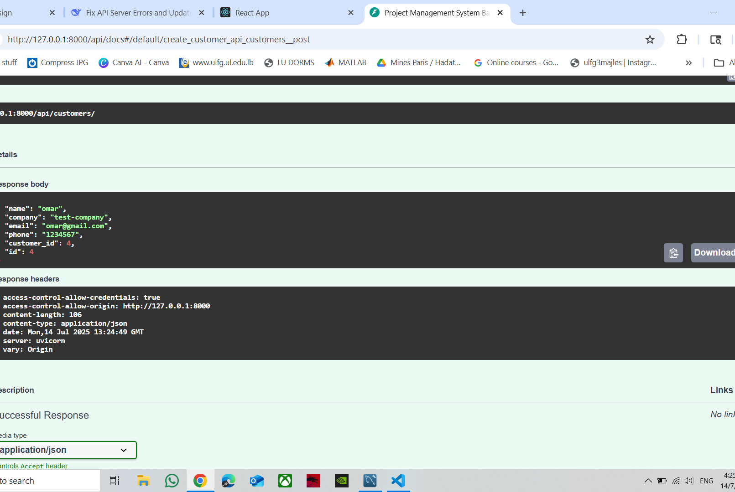
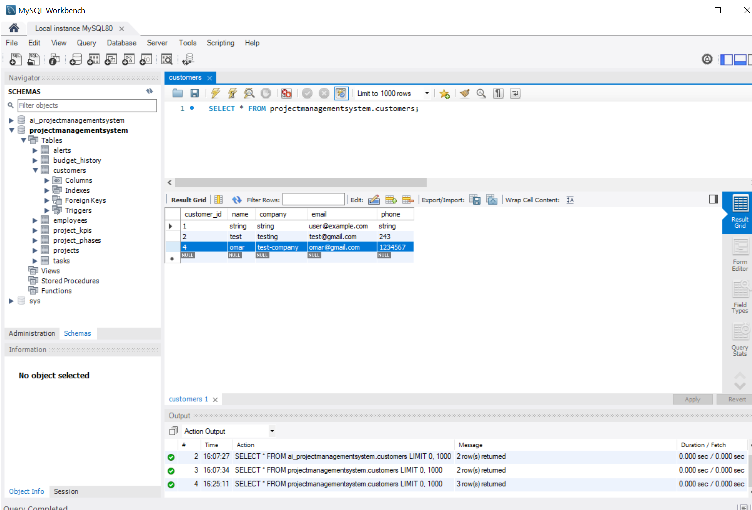

Slide 7

Database Design – Structure
Main Points:
Built with MySQL
Models represent real-world entities:
Customers – with contact info and company
Projects – linked to customers, with budget, status, etc.
Employees – with login info and preferences
Tasks – linked to projects and employees
Alerts – created by AI or manually
KPIs & Budget History – used by the AI agent

Slide 8
Projects Table
Customers Table
Field | Type | Description
project_id | INT (PK) | Unique project ID
project_name | VARCHAR(100) | Project title
customer_id | INT (FK) | Linked to Customers
status | ENUM | Project state
completion_percentage | DECIMAL(5,2) | Progress in %
budget_total | DECIMAL(12,2) | Total budget
budget_used | DECIMAL(12,2) | Used budget
budget_status | ENUM | Budget performance
start_date | DATE | Project start date
launch_date | DATE | Planned launch date
Field | Type | Description
customer_id | INT (PK) | Unique customer ID
name | VARCHAR(100) | Customer name
company | VARCHAR(100) | Company name
email | VARCHAR(100) | Email address
phone | VARCHAR(20) | Phone number
Employees Table
Field | Type | Description
employee_id | INT (PK) | Unique employee ID
name | VARCHAR(100) | Full name
email | VARCHAR(100) | Unique email
password_hash | VARCHAR(255) | Password (hashed)

Slide 9
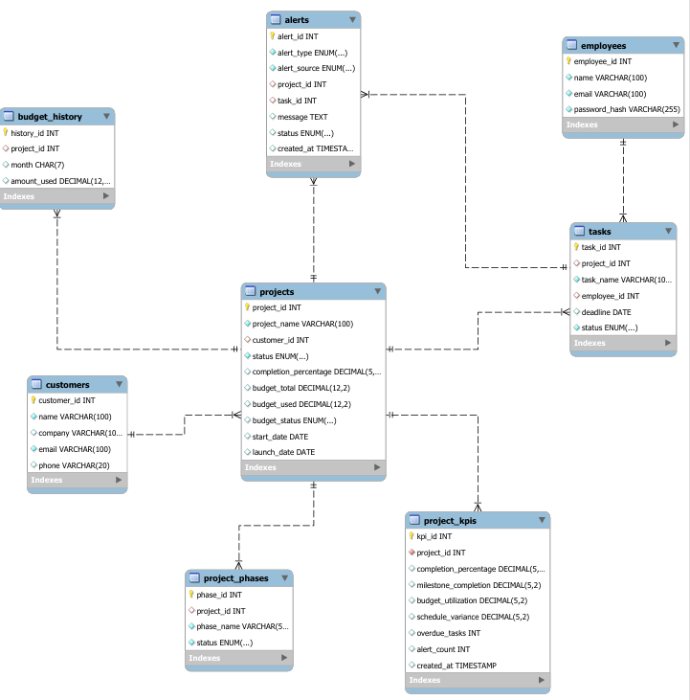

Slide 10

Frontend Implementation
Framework: React for responsive UI
Routing: React Router DOM
State Management: Context API
Charts: Recharts for visualizing KPIs
Modules include:
Dashboard: Visual stats & KPIs
Projects & Tasks: Add, update, filter
Customers: View & link to projects
Alerts: Status filters, mark as read

Slide 11
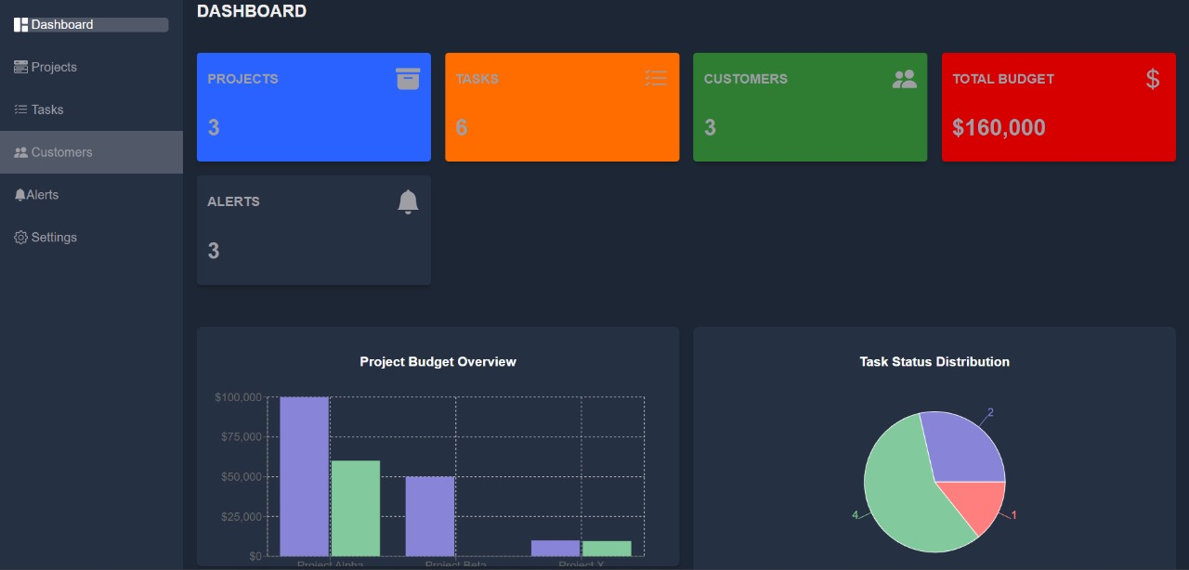
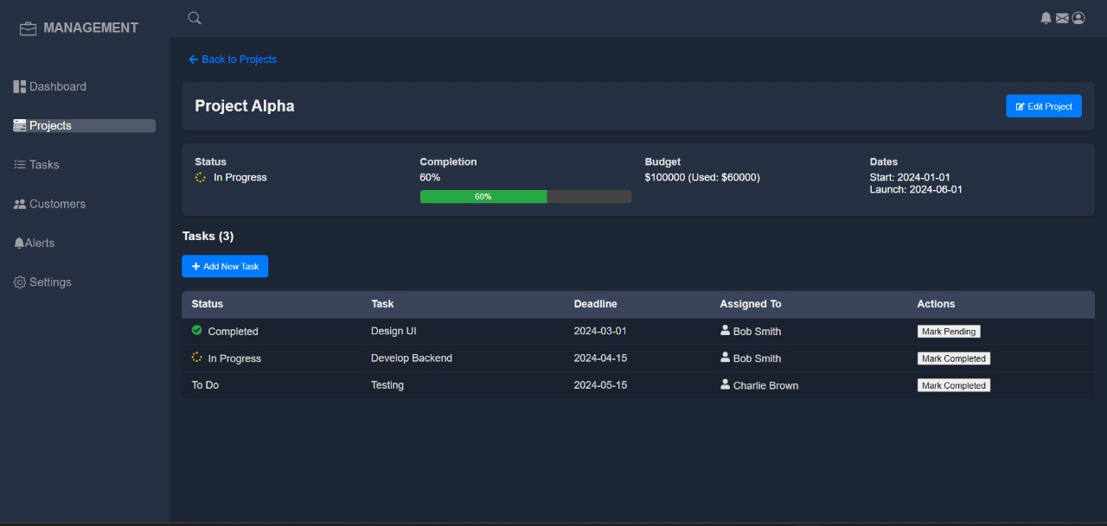

Slide 12
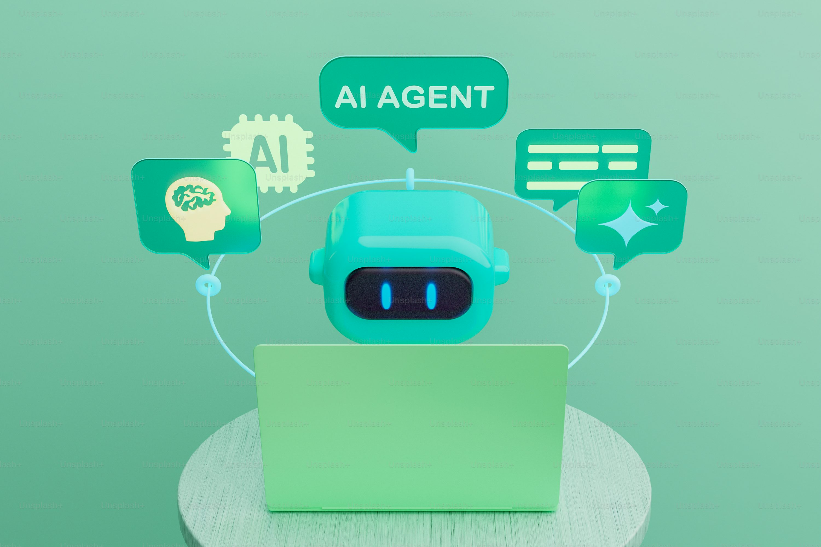
AI Agent – “Lama3”: The Intelligence Core
Role:
Smart AI agent for classifying project performance
Function:
Analyzes key performance indicators (KPIs) and outputs a KPI class
Inputs:
Completion Percentage
Milestone Completion
Budget Utilization
Schedule Variance
Overdue Tasks
Alert Count
Average Task Completion Time
Employee Workload Index
Customer Priority Level
Reopened Tasks
Risk Flag

Slide 13
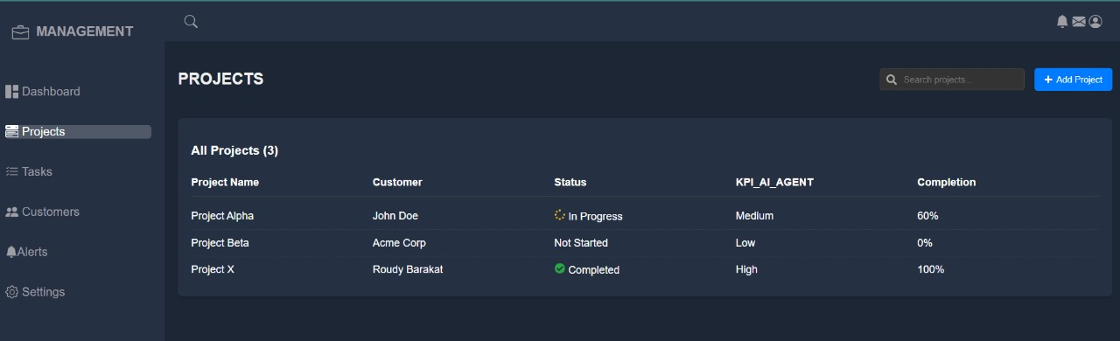
AI Agent – “Lama3”: Output
Output:
KPI Class → Low, Medium or High
Triggers alerts when risk is detected

Slide 14

How the AI Agent Works
KPI Data Collection:
Pulled from Project_KPIs table in MySQL
Prompt Construction:
Project data is formatted into a natural language prompt
API Call to Llama3:
FastAPI backend sends the prompt to the local Llama3 model
AI Classification:
Llama3 analyzes the prompt and returns a KPI class
Integration:
The result is stored and used to update dashboards or trigger alerts

Slide 15

Role-Based AI Design
Defined Roles of the Agent:
KPI Classifier: Evaluates overall project health
Risk Detector: Flags critical issues automatically
Advantages:
Modular design (easy upgrades)
Autonomy (works without manual intervention)
Explainability (decisions are traceable)
Seamless integration with backend logic

Slide 16

Conclusion
AI-enabled system for proactive project management
Combines FastAPI backend, React frontend, MySQL DB
"Lama3" agent = smart, explainable, autonomous
Supports ethical AI practices and real-time decisions

